Slide 1
Community Reinvestment Act (CRA) Reform Q&A
July 21, 2022

Slide 2
Options to Join
Webinar and audio
Webinar and phone
Phone only
Click on the link: https://www.webcaster4.com/Webcast/Page/584/45870
Call-in number: 888-290-7497
Call-in number: 888-625-5230
Enter the participant code: 926 389 46#.
Enter the participant code: 161 445 80#.
Choose to listen with your phone.
Click on the link: https://www.webcaster4.com/Webcast/Page/584/45870
Choose to listen with your PC speakers

Slide 3
Questions
During the call, you can submit questions several ways.
Via webinar chat: You can submit a question via the Ask Question button in the webinar tool. Your question will only be seen by our presenters.
Via email: conversations@stls.frb.org

Slide 4
Today’s Presenters
Caleb Bobo
Supervisory Examiner/CRA Program Manager Federal Reserve Bank of St. Louis
Alejandra Lopez-Fernandini Lead Supervisory Policy Analyst
Federal Reserve Board of Governors
Jessica Farr CRA Subject Matter Expert
Federal Reserve Bank of Atlanta

Slide 5
Disclaimer
The opinions expressed in the presentations are intended for informational purposes and are not formal opinions of, nor binding on the Federal Reserve Bank of St. Louis or the Board of Governors of the Federal Reserve System.

Slide 6
Agenda
Rulemaking Process Summary
Objectives of the Interagency NPR
High-Level Overview of the NPR
Q&A

Slide 7
Process Summary
Interagency efforts to revamp and modernize the CRA have been ongoing for several years. The following represents significant milestones in the process:
August 2018 – OCC issues an ANPR on modernizing CRA
December 2019 – OCC/FDIC issue joint NPR
May 2020 – OCC issues Final Rule
September 2020 – FRS issues ANPR on modernizing CRA
July 2021 – OCC announces intention to rescind its Final Rule
July 2021 – FRS/FDIC/OCC announce intention to pursue CRA modernization together
December 2021 – OCC rescinds its Final Rule
May 2022 – Interagency NPR is released

Slide 8
Objectives of the NPR
The NPR builds on previous agency proposals, feedback from stakeholders, and research. The following objectives oriented the interagency work to update the CRA regulations:
Strengthen the achievement of the core purpose of the statute
Adapt to changes in the banking industry, including mobile and online banking
Provide greater clarity and consistency in the application of the regulations
Tailor performance standards to account for differences in bank size, business model, and local conditions
Tailor data collection and reporting requirements and use existing data whenever possible
Promote transparency and public engagement
Confirm that CRA and fair lending responsibilities are mutually reinforcing
Create a consistent regulatory approach among all three banking agencies

Slide 9
Overview
Proposed modifications in the NPR include:
Expanding Community Development (CD) Definitions
Creating New Types of Assessment Areas
Revising Component Tests for Large Banks
Revising Bank Size Categories
Creating a Metric/Benchmark Centered Assessment
Creating a CD Financing Test
Revising the Strategic Plan CRA Option
Requiring new Data Collection/Reporting for large banks

Slide 10
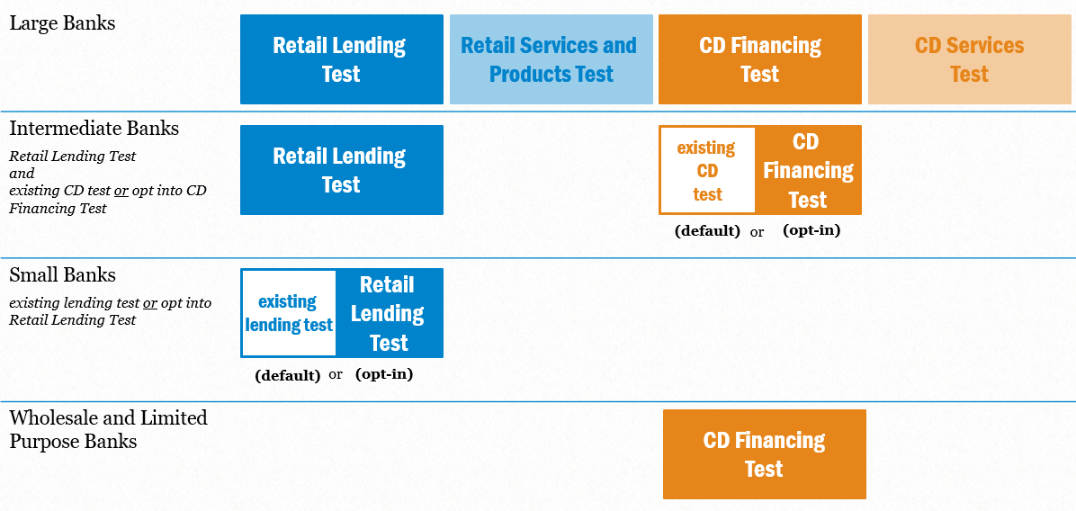
Overall Evaluation Framework

Slide 11
Questions?
Caleb Bobo
Supervisory Examiner/CRA Program Manager Federal Reserve Bank of St. Louis
Alejandra Lopez-Fernandini
Lead Supervisory Policy Analyst
Federal Reserve Board of Governors
Jessica Farr
CRA Subject Matter Expert
Federal Reserve Bank of Atlanta
Via webinar chat: You can submit a question via the Ask Question button in the webinar tool. Your question will only be seen by our presenters.
Via email: conversations@stls.frb.org

Slide 12
Comment Submission
Comment period ends on August 5, 2022.
Comments can be submitted to any of the three agencies and all comments will be shared between the agencies. Refer to the NPR for additional details.
Board:
Submit a comment using the link on: https://www.federalreserve.gov/consumerscommunities/community-reinvestment-act-proposed-rulemaking.htm
Comments can also be emailed, faxed, or mailed.
OCC:
Submit a comment here: Go to https://regulations.gov/. Enter “Docket ID OCC-2022-0002” in the Search Box and click “Search.”
Comments can also be mailed or hand-delivered.
FDIC:
Submit a comment here: http://www.fdic.gov/regulations/laws/federal/propose.html. Include the RIN 3064 -AF81 on the subject line of the message.
Comments can also be emailed, mailed, or hand-delivered.

